Slide 1
GREAT OUTDOORS
Group A : Ankush Agrawal Sarthak Lav Shreyash Pandey Madhuri Vemulapaty Sourav Maji

Slide 2
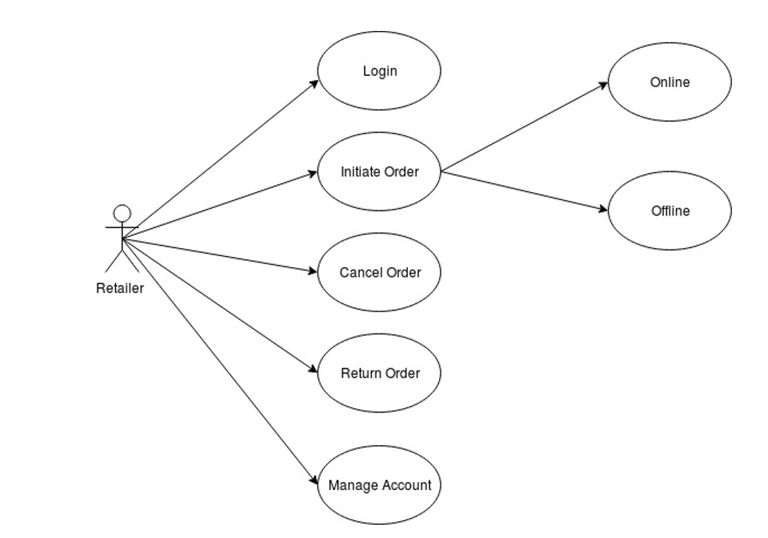
Retailer Use Case Diagram

Slide 3
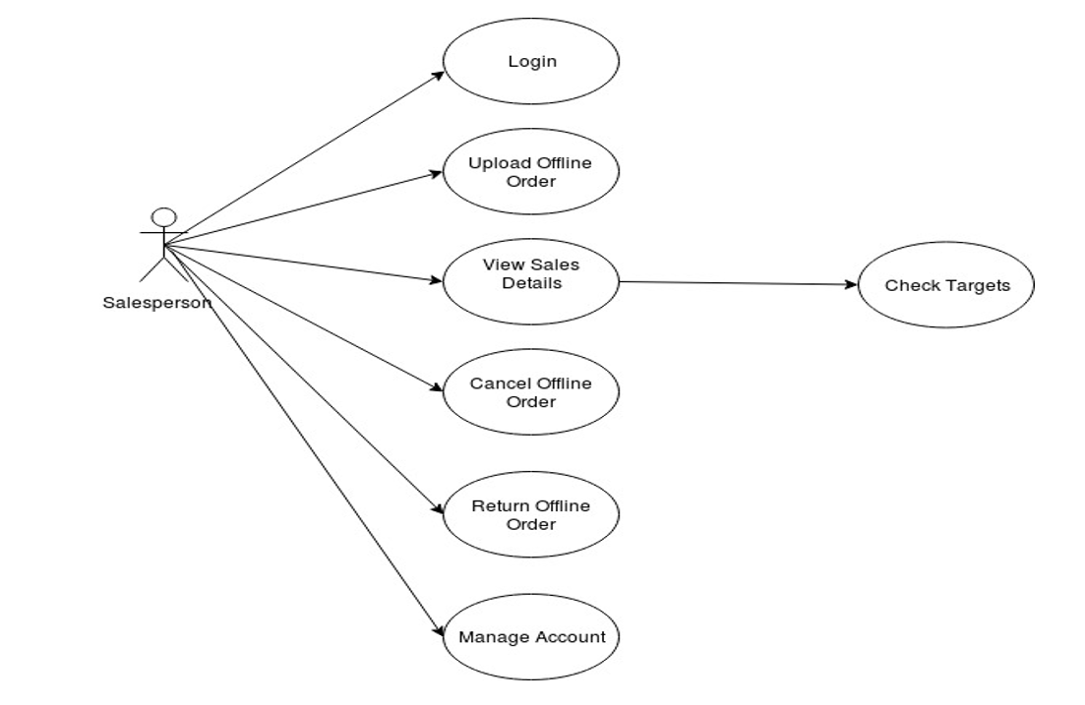
Salesperson Use Case Diagram

Slide 4
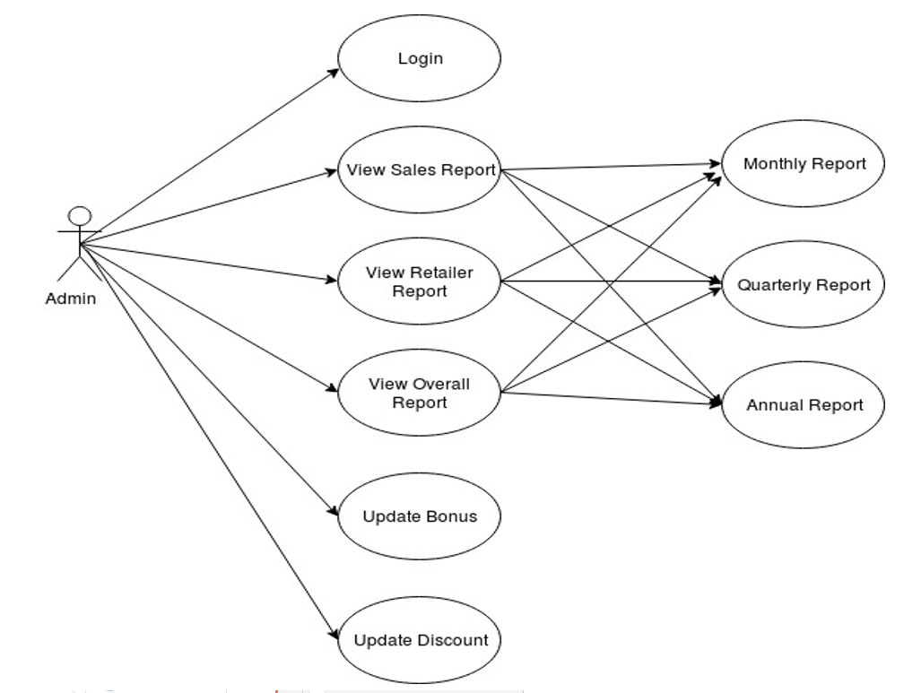
Admin Use Case Diagram

Slide 5
EPIC – Salesman Homepage
User Story : Return/Cancel Offline Order
Salesman should be able to view the orders placed by him.
If an offline request to return/cancel the order arrives, he should be able to upload them.
Salesman logs in and initiates the return order.
Return Order shows the salesman all the order history.
Salesman selects the OrderID and cause of Return/Cancel.
This generates a Return/Cancel ID which helps in tracking the refunds and the product being returned.
Direct back to salesman home page.

Slide 6
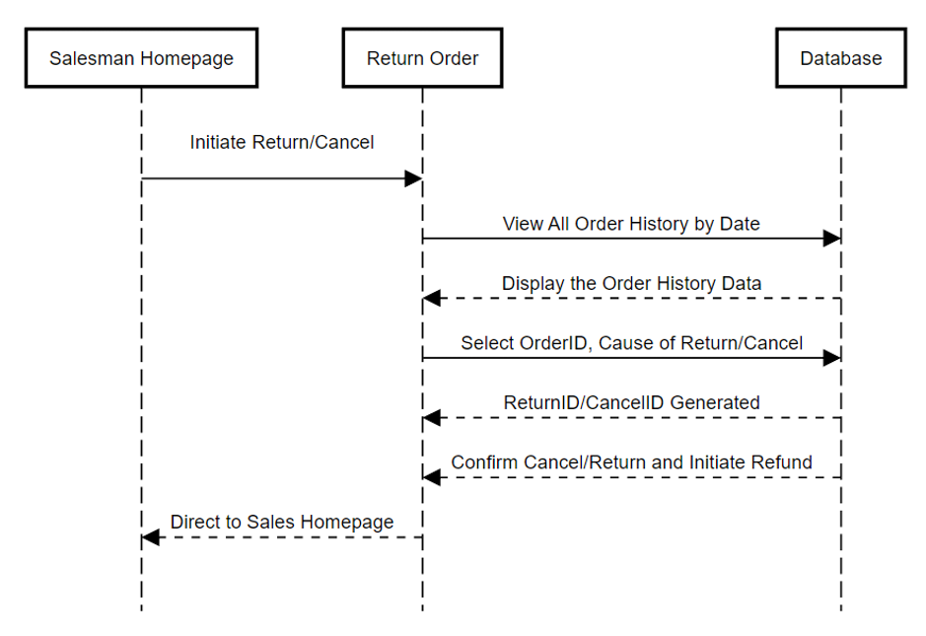
Sequence Diagram of Return/Cancel Order Offline

Slide 7
EPIC – Retailer Homepage
User Story : Change Online Order if not processed
Retailer should be able to change product if they want but before processing completed.
Retailer views his past orders which are under processing.
Selects the order and initiate the request to change it. He is then directed to the Product Display homepage.
Select the alternate product, quantity and the address.
Confirm the order which then manages the cost difference. This generates a new OrderID.

Slide 8
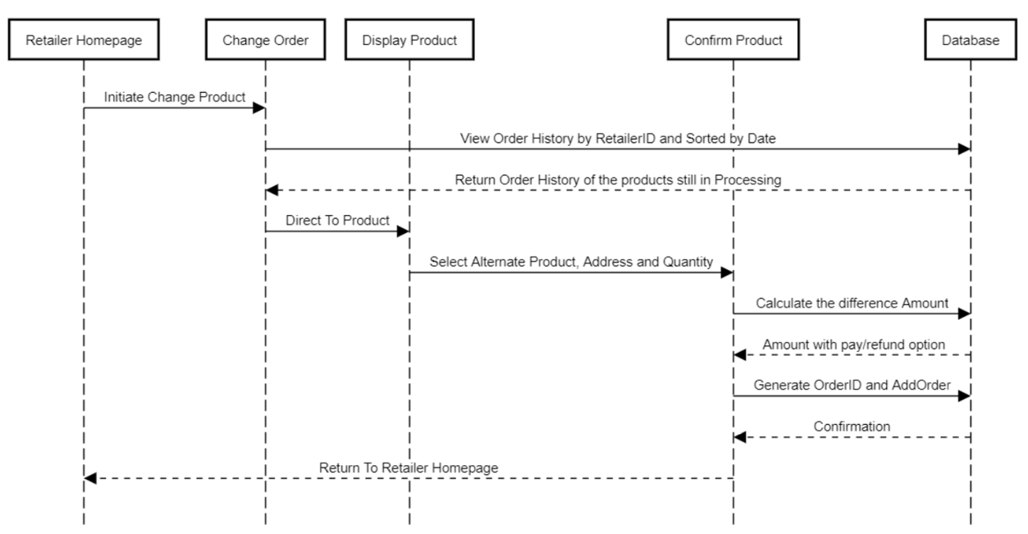
Sequence Diagram of Online Change Product By Retailer

Slide 9
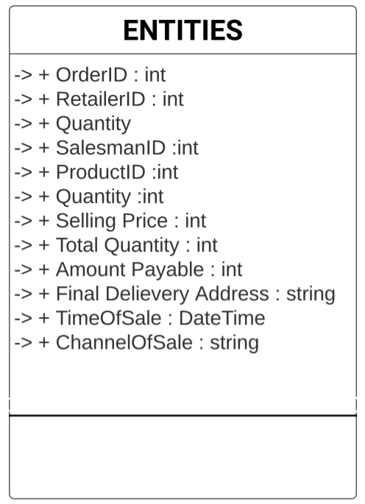
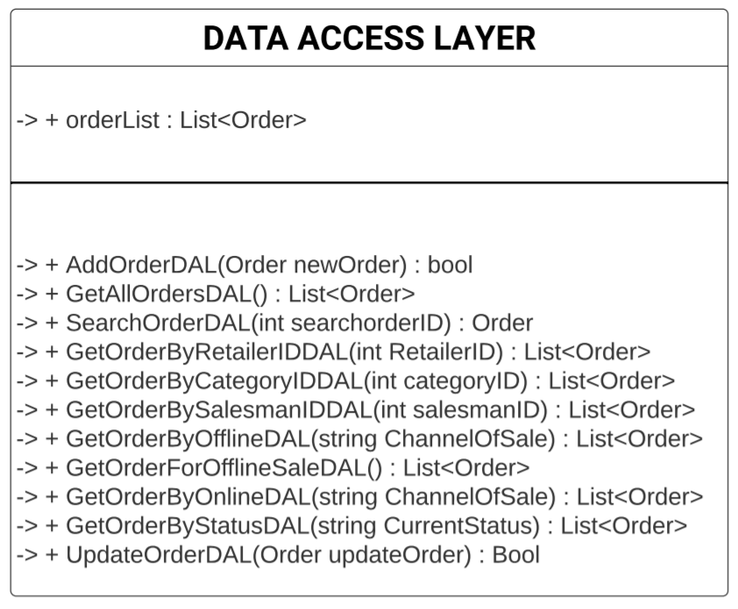
Order Class Diagram

Slide 10
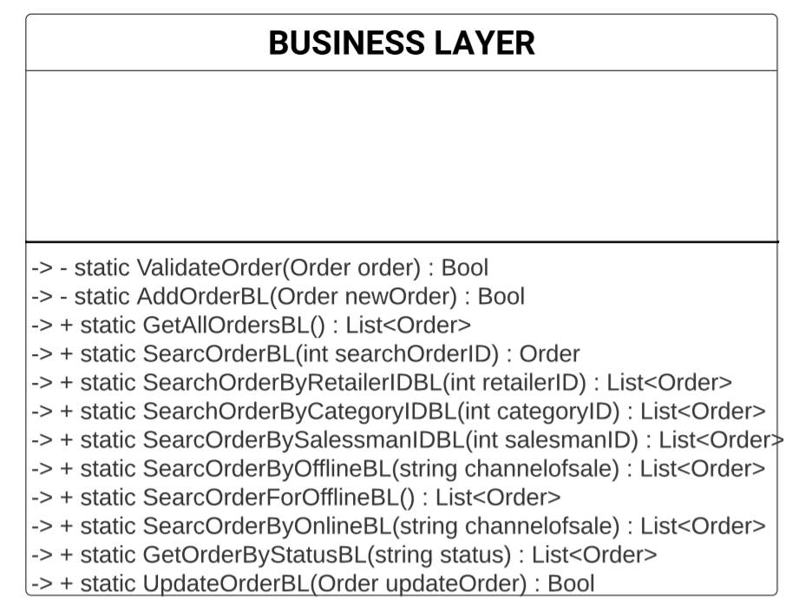
Order Class Diagram

Slide 11
THANK YOU

